Slide 1

Executive Mobile Computing Mobile App Demonstration
Group Member:
S4584569 Alev Akturk
S4576075 Dinh Sang Tran
S4586540 Japneet Kaur MALLI

Slide 2
Overview
Strategic document elements
Discussion of prototype
Demonstration of SeekHelp
Technical expertise
Initial ambition & achieved
Lessons learned

Slide 3
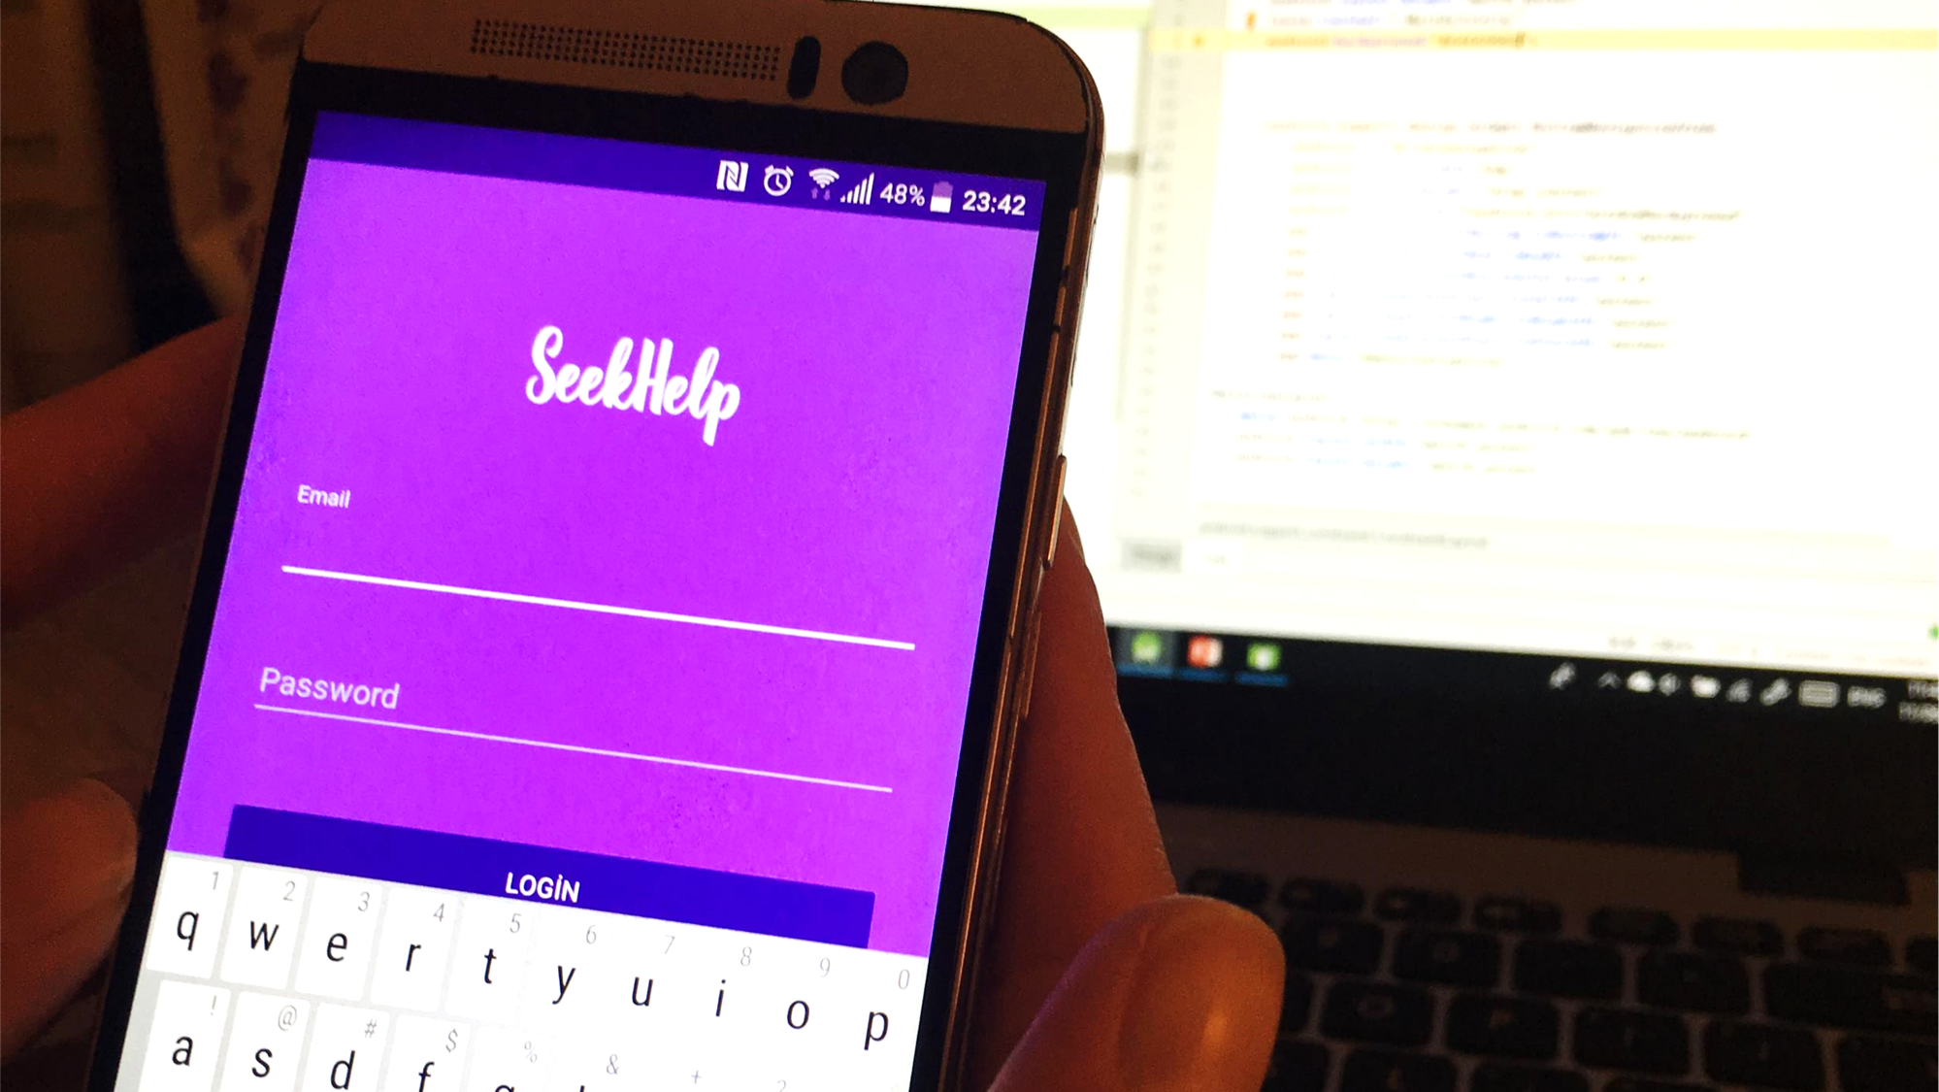
ABOUT THE APP
Voluntary work app
The aim is help people who is old or disable

Slide 4
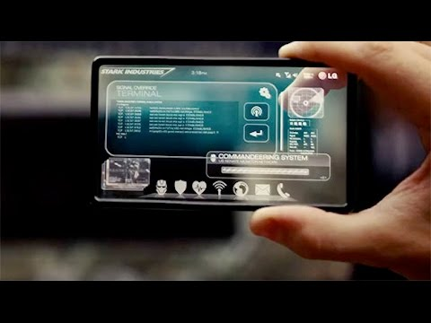

Strategic Document Elements
Current Status
Business Drivers
Technological innovation
Communication and Cooperation among people
Key issues
Identify the purpose of the application
Choose a better suitable platform for the app development
Lay out the flow and features
Simplify UI design by limiting animations and transitions
Current Technologies
Programing languages: Swift, Java, HTML5, C#, C++..
Multi Platform Tools: PhoneGap, Mosync..
Other: IOT, AI, Wearable Devices
Future Status
Tangible Benefits: Creating user friendly interface
Intangible Benefits: Help people who needs help
Stakeholders

Slide 5
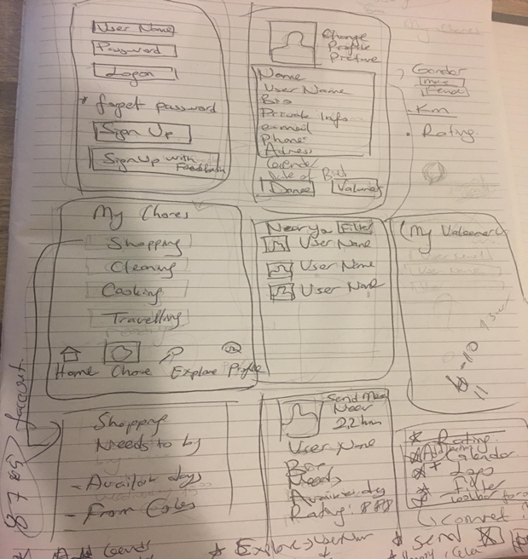
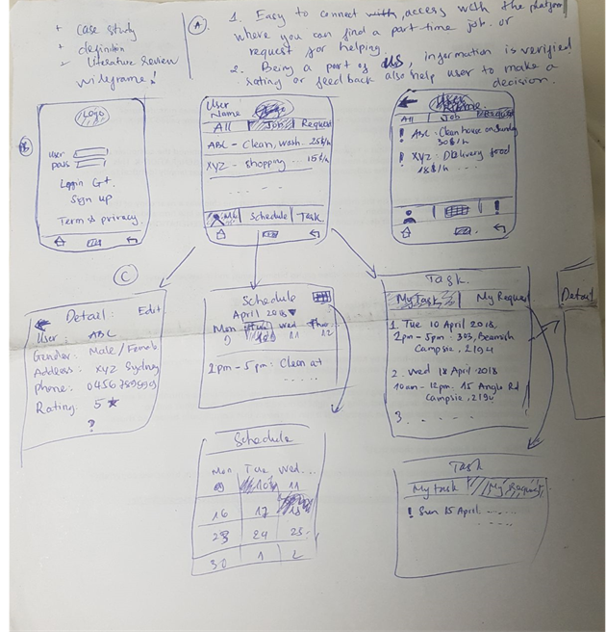
Sketches
Discussion of Prototype

Slide 6
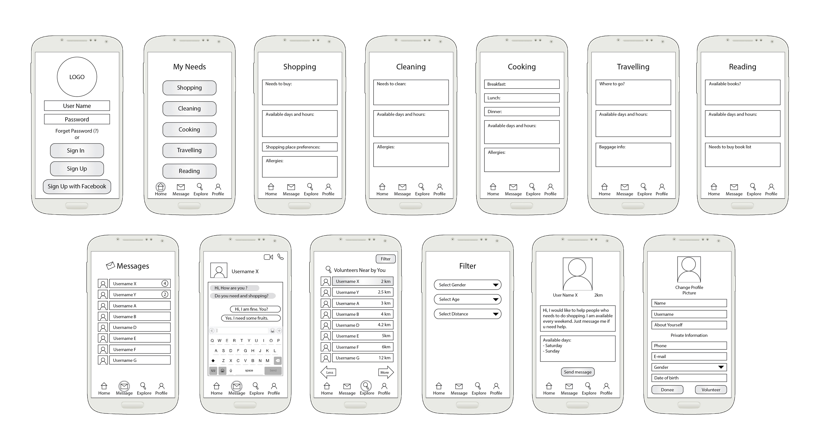
Wireframes
Discussion of Prototype

Slide 7
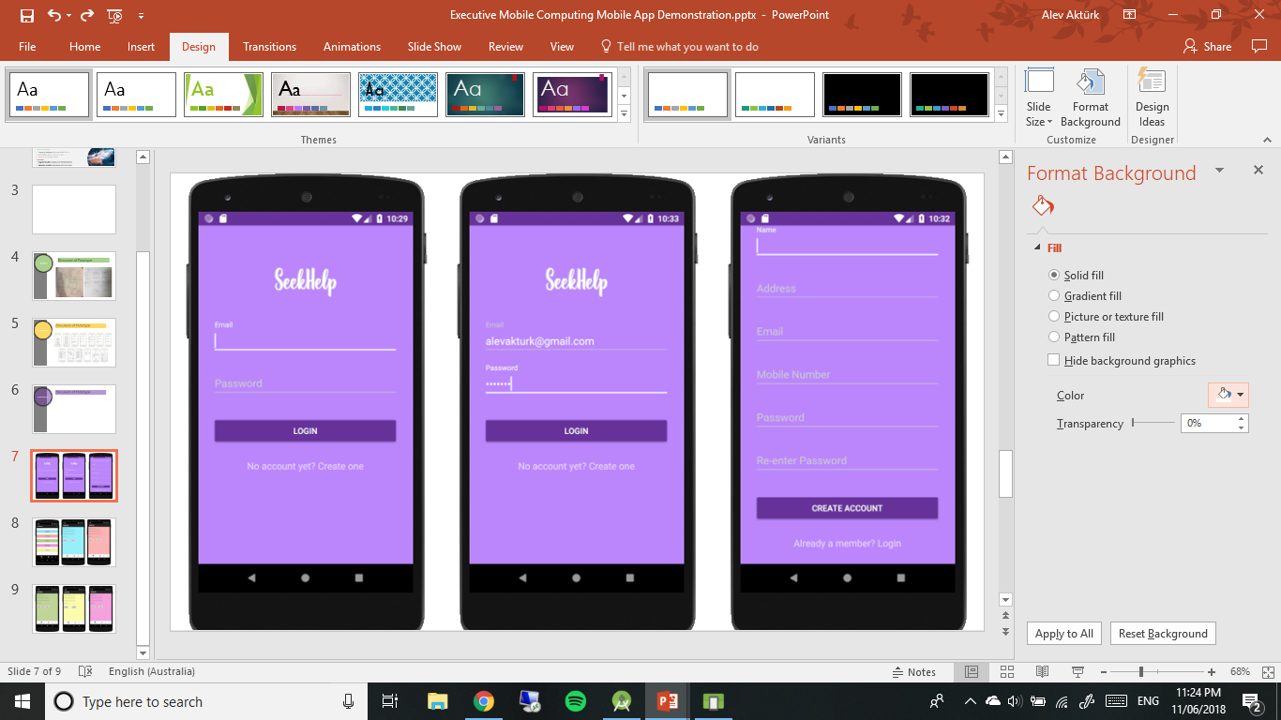
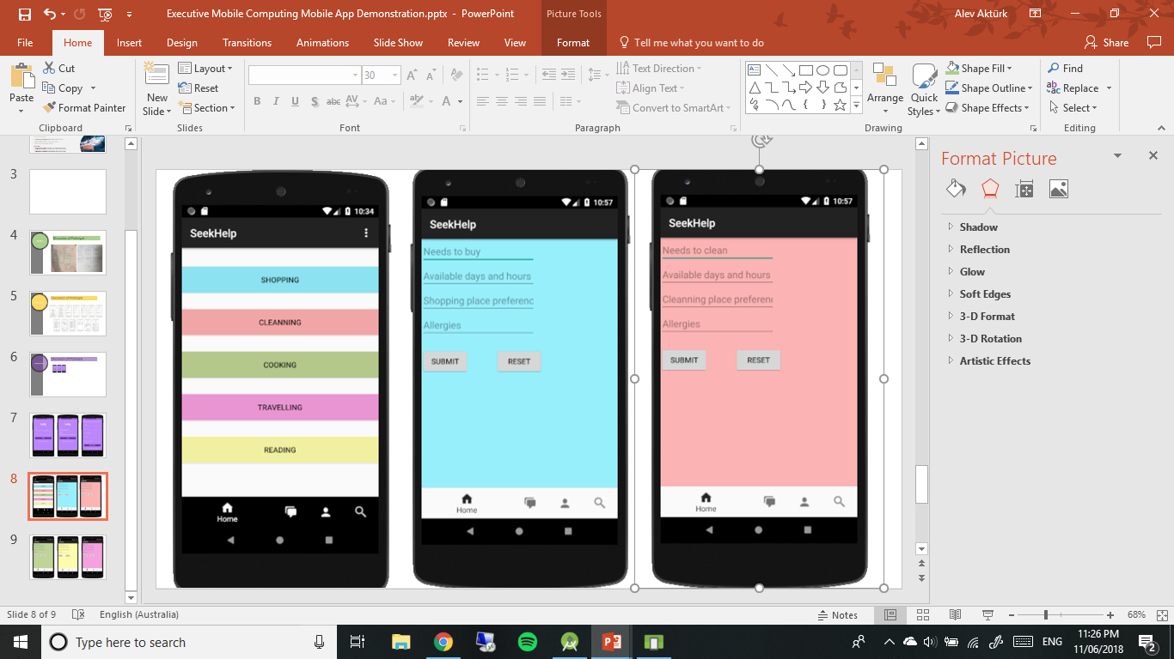
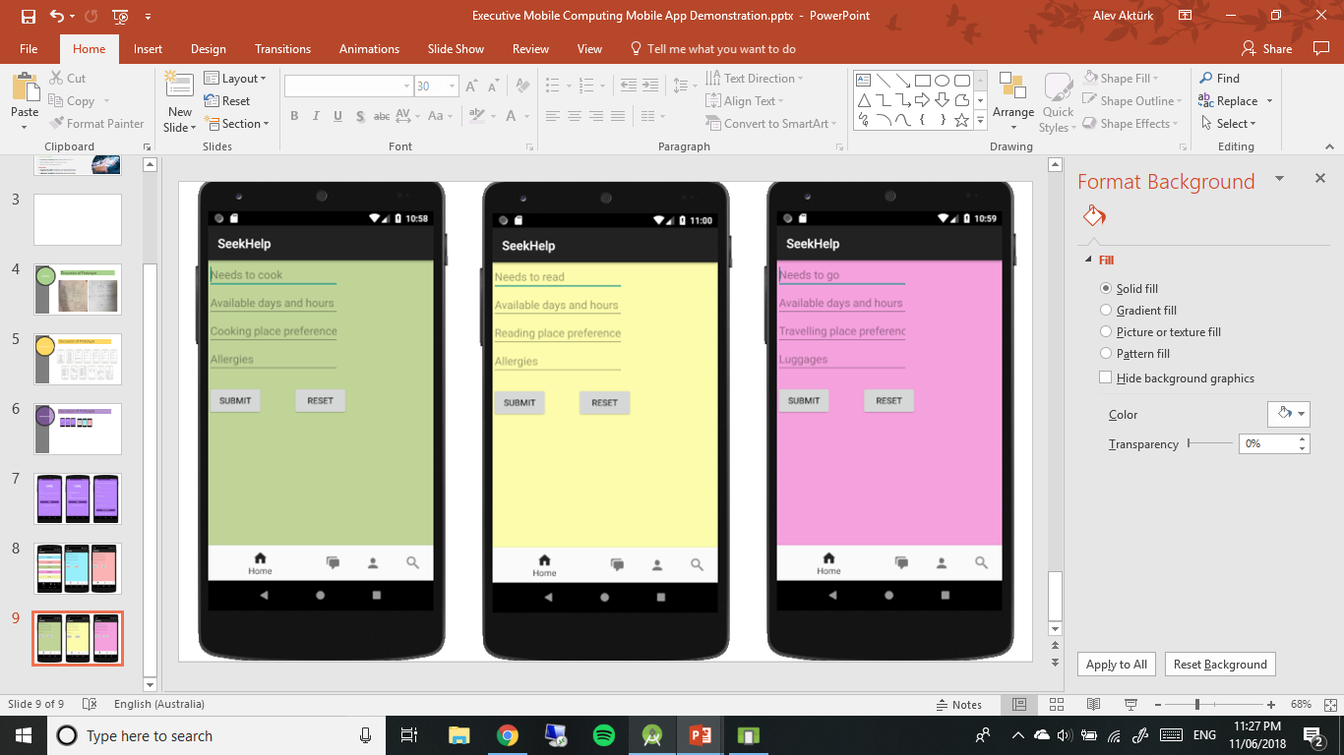
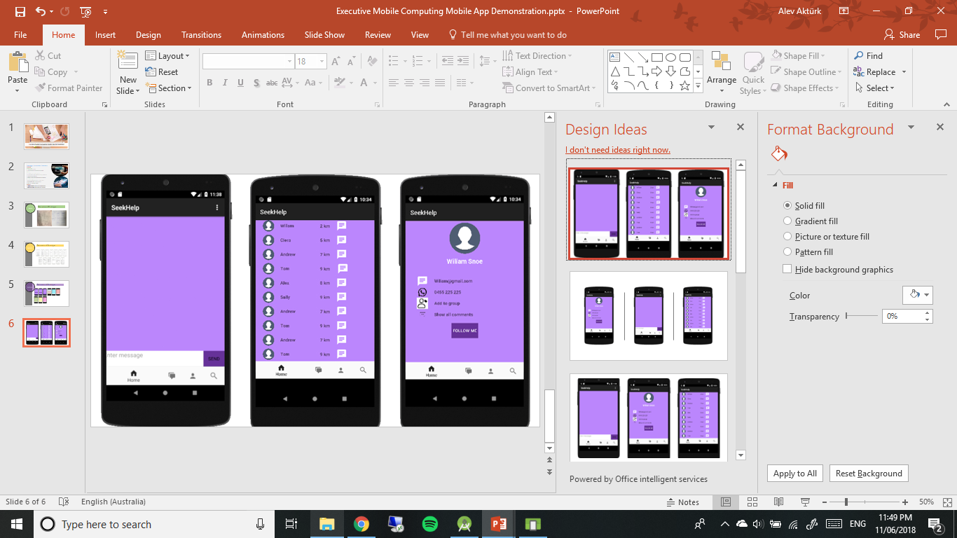
Real Screens
Discussion of Prototype

Slide 8
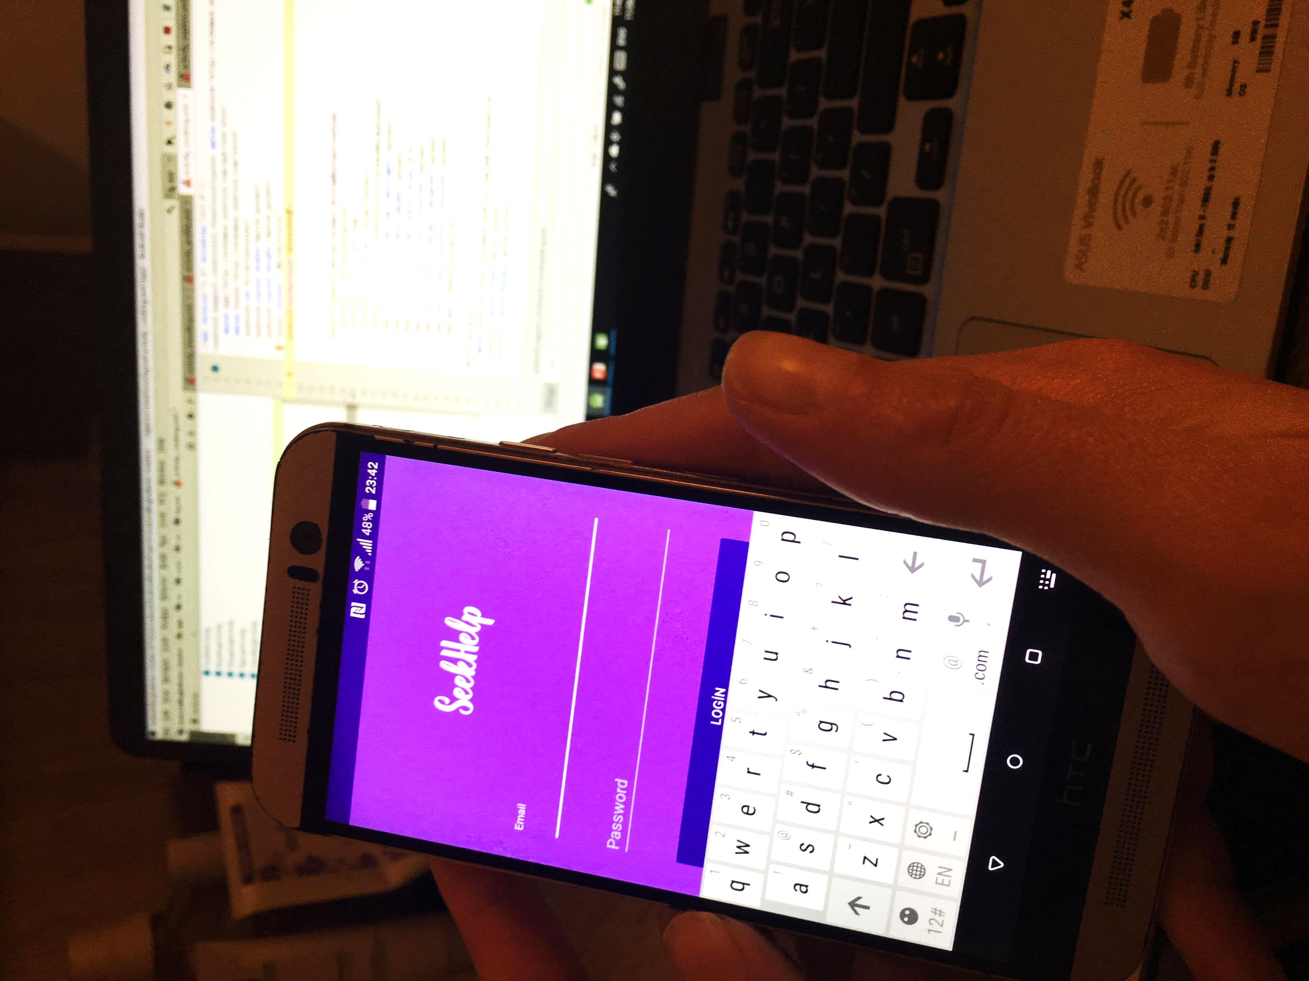
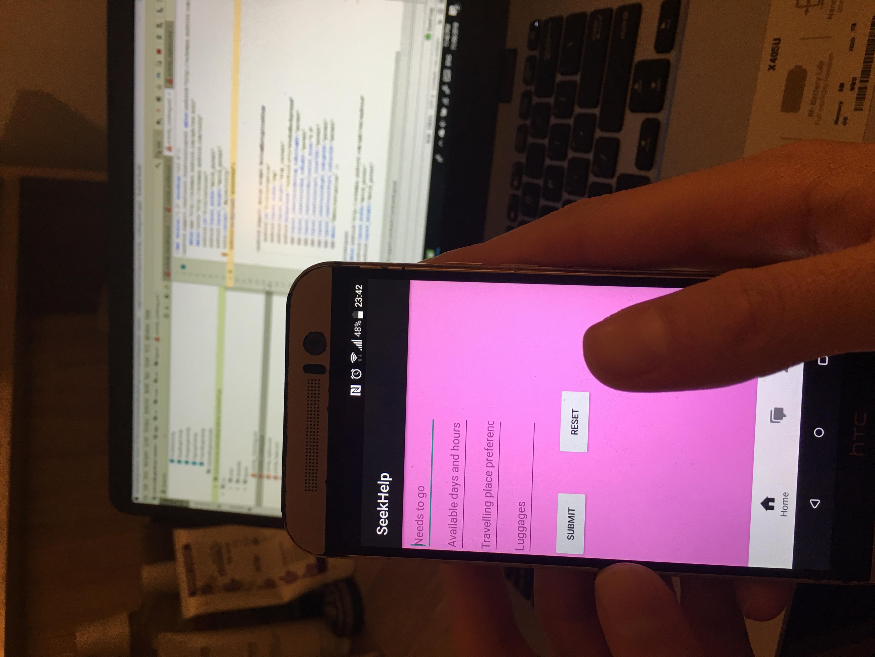
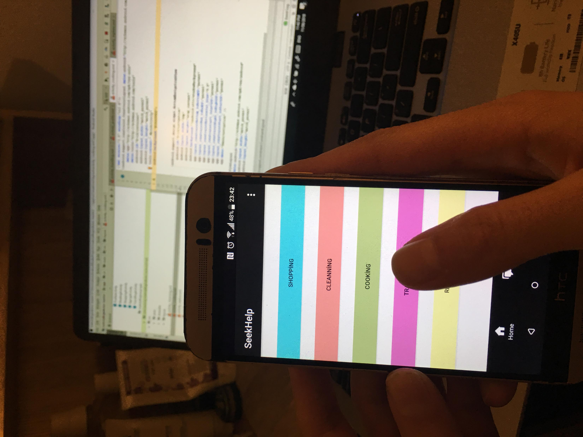
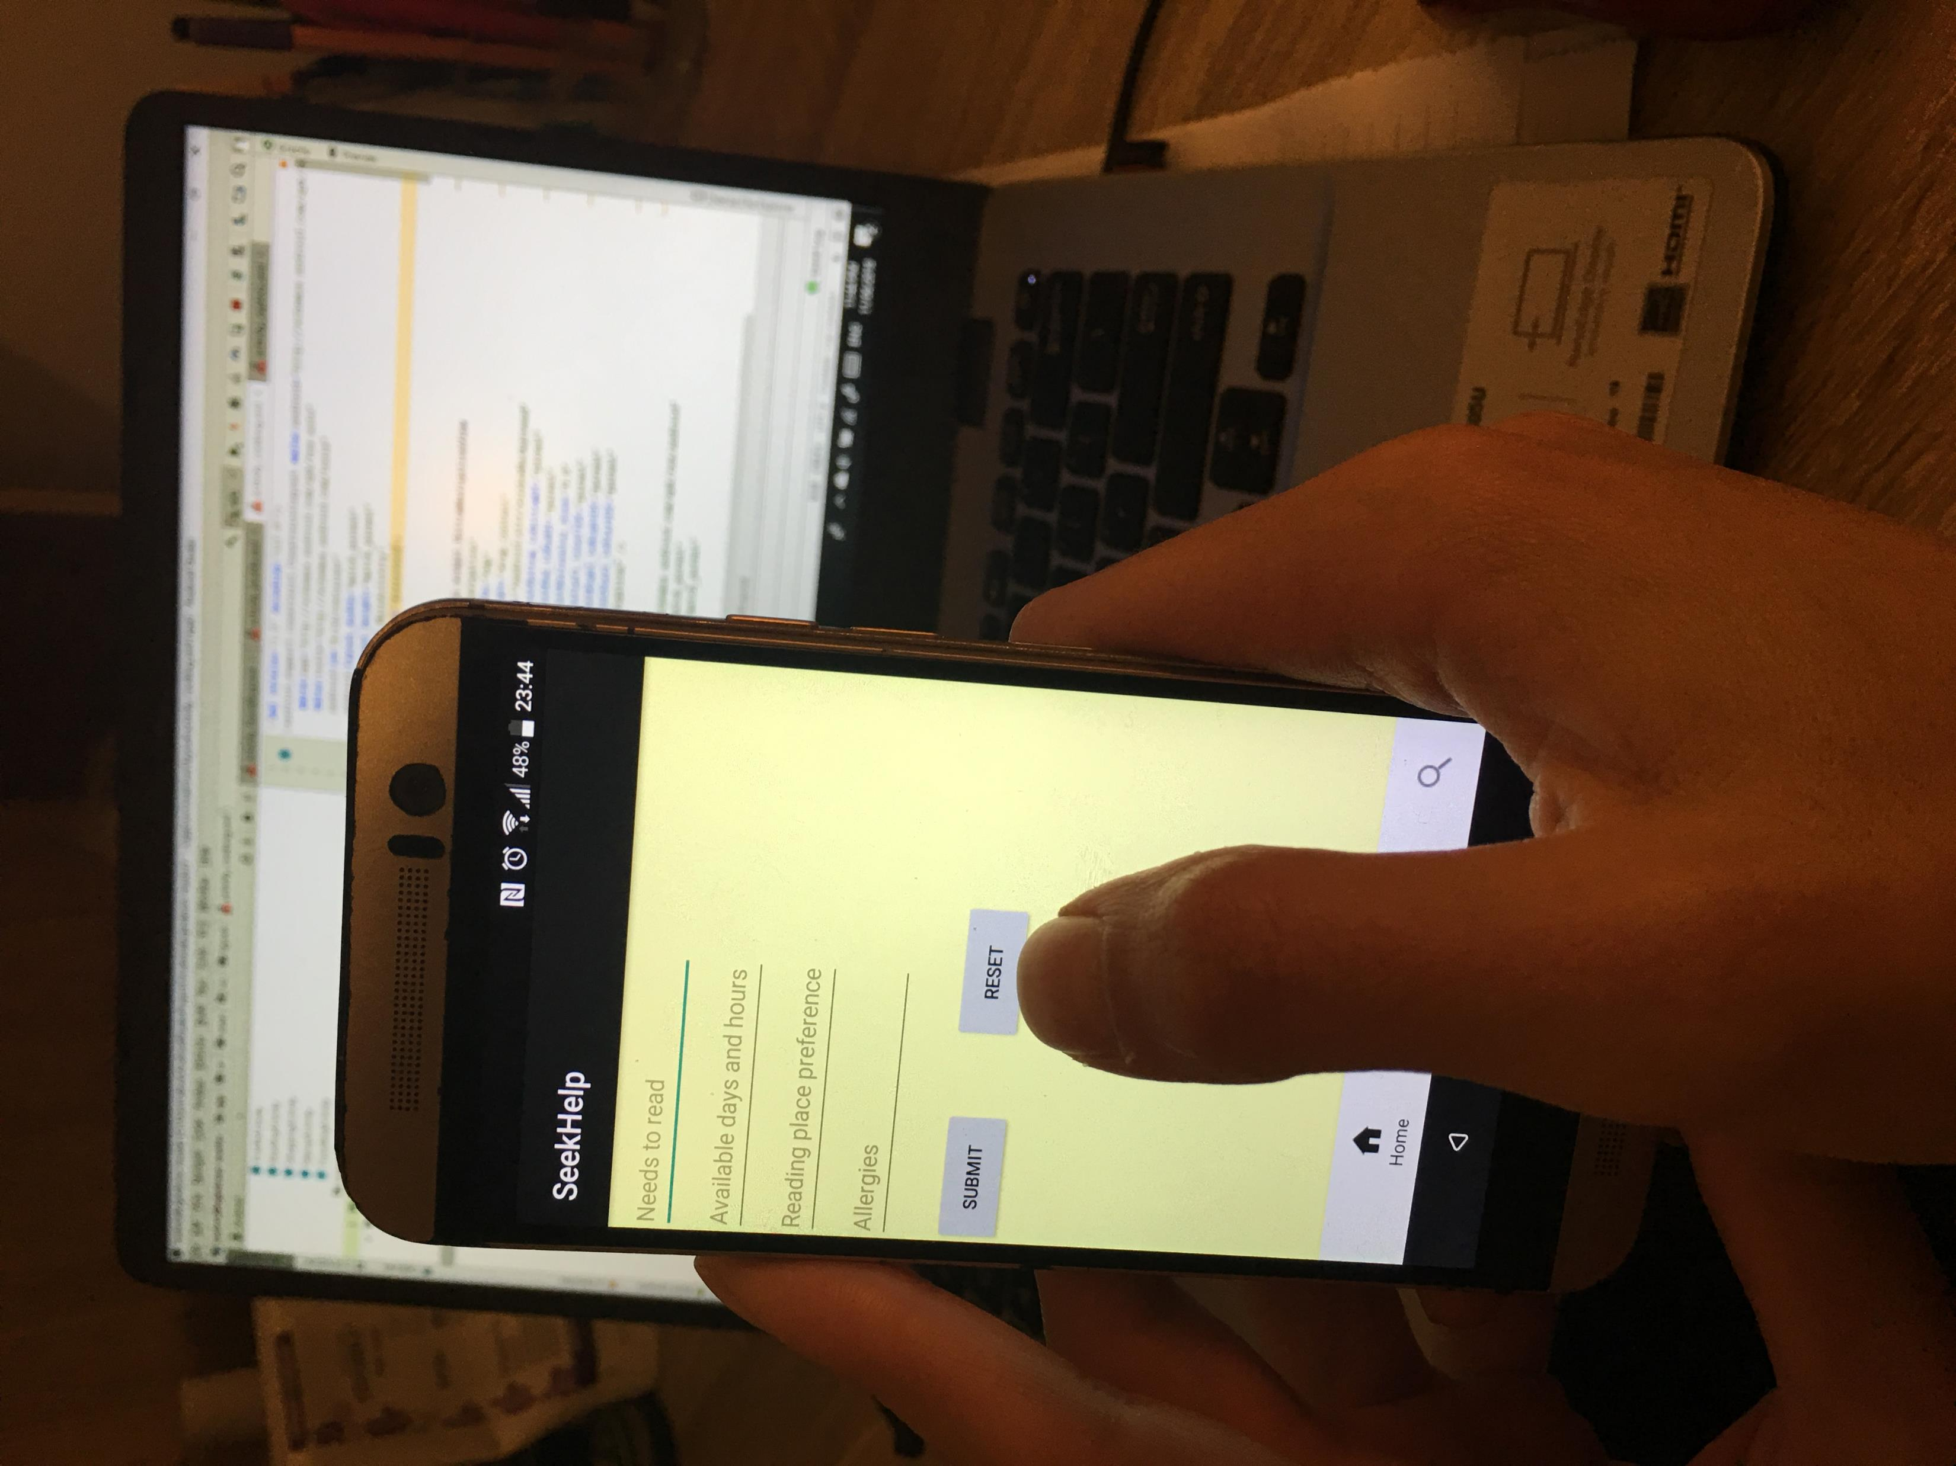
TECHNICAL EXPERTISE

Slide 9
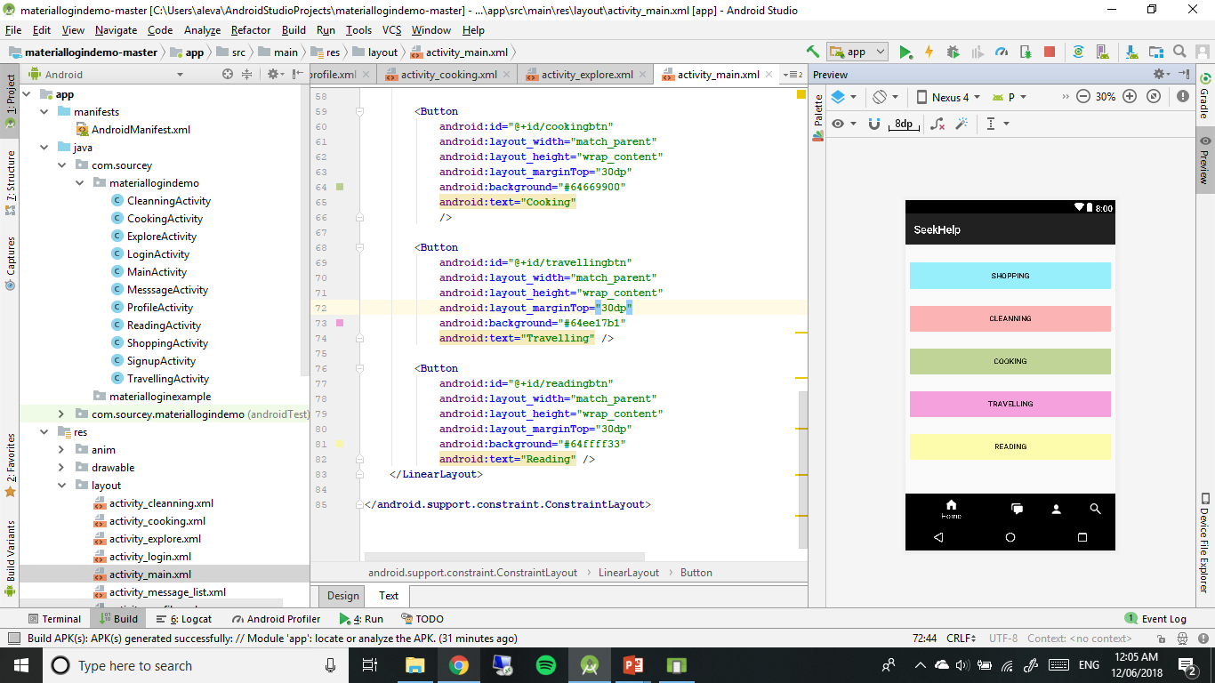
TECHNICAL EXPERTISE
TECHNICAL EXPERTISE

Slide 10

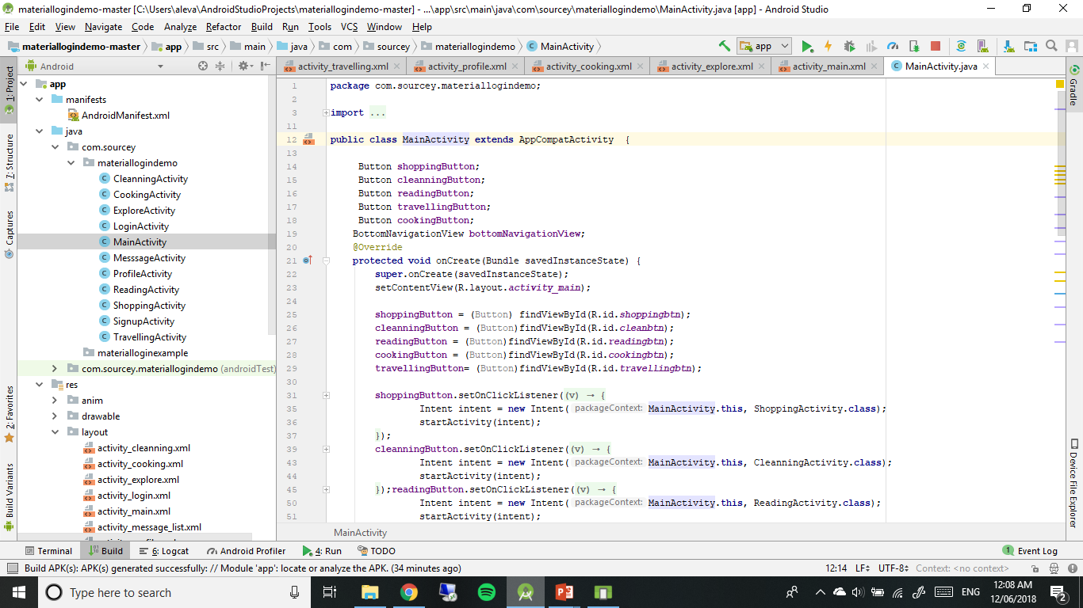

Slide 11
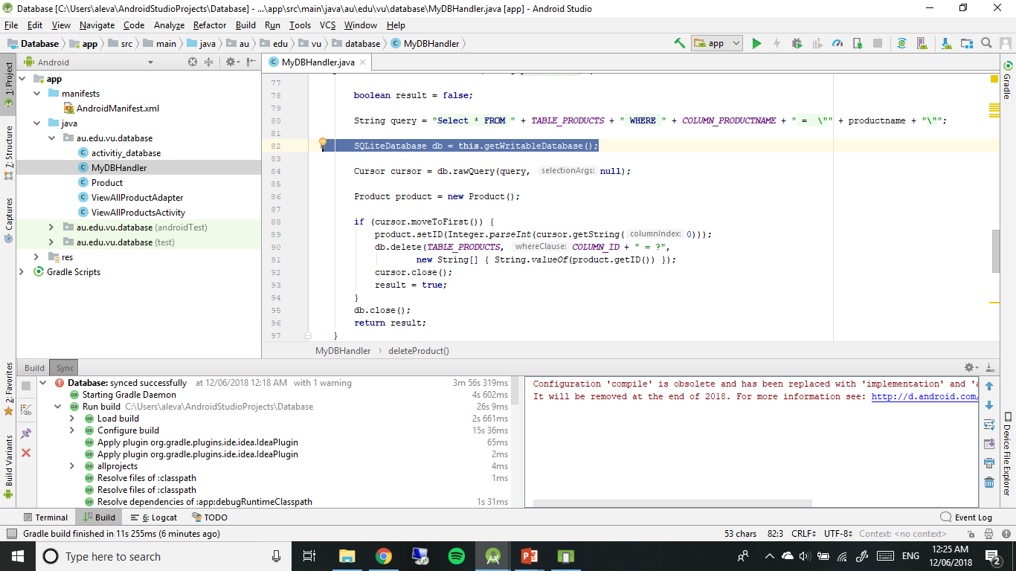
Database

Slide 12
Initial ambition and achieved
Helping people
Creating collaboration between young and old people
A platform for user to use easily

Slide 13
Lesson learnt
The Project needed to be decomposed into smaller, more manageable parts as it it complex.
Taking note of the failures.
There should be clarity of project roles.
Prior planning regarding governance.
IT management.
Should take insights and feedback from professional.
Think about the bigger picture.
User involvement.
Executive support.
Understanding the target market.

Slide 14

THANK YOU

